Slide 1

Designing Of Shell And Tube Heat Exchanger Using MATLAB
Presented By :
Tanya Shambhawi
(Maulana Azad National Institute of Technology , Bhopal)
Guided by :
Mr. Shouvik Sarkar

Slide 2

Objective
This project aims to study the effects of baffle inclination on the performance of a shell and tube heat exchanger.
Calculating the overall heat transfer coefficient for different baffle inclinations.
Assessing the pressure drop across the heat exchanger at various baffle inclinations.
Evaluating the temperature distribution within the shell and tube sides of the heat exchanger for different baffle inclinations.
Determining the Reynolds and Nusselt numbers for both the shell and tube sides at different baffle inclinations.
Measuring the effectiveness of the heat exchanger, which indicates the efficiency of heat transfer between the fluids.
Analyzing the outlet temperatures of the shell and tube sides for varying baffle inclinations.
comprehensive analysis and visualization of these parameters to understand how changing the baffle inclination affects the overall performance of the heat exchanger. This analysis will help in optimizing the design and operation of the heat exchanger for improved thermal efficiency and fluid flow characteristics.

Slide 3
Why MATLAB ?
Comprehensive Mathematical and Statistical Tools: MATLAB offers a wide range of built-in functions and toolboxes that are specifically designed for mathematical, statistical, and engineering calculations. This is particularly beneficial for performing complex calculations involved in heat transfer and fluid dynamics.
Visualization Capabilities: MATLAB excels in data visualization, allowing you to create high-quality plots and graphical representations of data. This is useful for visualizing temperature profiles, pressure drops, heat transfer coefficients, and other key metrics in the heat exchanger.
Ease of Use: MATLAB's user-friendly interface and programming environment make it easier to develop, test, and debug code. Its extensive documentation and community support further simplify the learning process.
Simulation and Modeling: MATLAB provides powerful simulation and modeling tools, such as Simulink, which can be used to model and simulate the behavior of the heat exchanger under various conditions.
Integration with Other Tools: MATLAB can easily integrate with other software and tools, allowing you to import and export data, interface with hardware, and use MATLAB in conjunction with other programming languages like Python or C++.
Parallel Computing: MATLAB supports parallel computing, enabling you to perform computations faster by utilizing multiple processors. This is advantageous when dealing with large datasets or complex simulations.
Versatility: MATLAB can handle various types of data and perform a wide range of operations, making it suitable for multidisciplinary projects that require numerical analysis, data processing, and visualization.
Pre-built Functions and Toolboxes: MATLAB's extensive library of pre-built functions and specialized toolboxes (such as the Control System Toolbox, Optimization Toolbox, and Fluid Dynamics Toolbox) can significantly reduce the time and effort required to develop and implement complex algorithms.

Slide 4
THEORY
A shell and tube heat exchanger is a type of heat exchanger that consists of a series of tubes, one set carrying the hot fluid and the other carrying the cold fluid. Heat is transferred between the fluids through the tube walls, either from the shell side to the tube side or vice versa.
Structure and Components
The main components of a shell and tube heat exchanger include:
Shell: A large pressure vessel that contains the tube bundle.
Tubes: Thin-walled tubes that carry one of the fluids. They are usually made of materials with high thermal conductivity.
Tube Sheets: Plates to which the tubes are fixed at both ends.
Baffles: Plates that direct the flow of the fluid within the shell, enhancing heat transfer by increasing turbulence.
End Caps (Heads): These are fitted to the ends of the shell and tube heat exchanger to direct the flow into and out of the tubes.

Slide 5
Working Principle
The basic operation of a shell and tube heat exchanger involves two fluids at different temperatures flowing through the exchanger. One fluid flows through the tubes (tube side) while the other fluid flows outside the tubes but inside the shell (shell side). The fluids can flow in either a parallel (co-current) or opposite (counter-current) direction.
Heat Transfer Mechanism: Heat transfer in a shell and tube heat exchanger occurs by conduction through the tube walls, followed by convection to the shell-side and tube-side fluids.
2. Heat Transfer Coefficient: The overall heat transfer coefficient (U) is a measure of the heat exchanger’s ability to transfer heat. It depends on the heat transfer coefficients of both fluids, the thermal conductivity of the tube material, and the geometry of the heat exchanger.
Types of Shell and Tube Heat Exchangers
Fixed Tube Sheet Design: Tubes are fixed to tube sheets at both ends. It is simple but not suitable for handling high-temperature differences due to thermal expansion issues.
Floating Head Design: One end of the tubes is fixed, and the other end is free to move. This design accommodates differential thermal expansion.
U-tube Design: Tubes are bent into a U-shape, allowing for differential thermal expansion. Suitable for high-pressure applications.

Slide 6
Performance Parameters
Effectiveness (ε): The ratio of the actual heat transfer to the maximum possible heat transfer.
Number of Transfer Units (NTU): A dimensionless parameter used to describe the heat exchanger’s performance, defined as NTU=​UA/Cmin ​.
Pressure Drop: The pressure loss that occurs as fluid flows through the heat exchanger, influenced by factors such as fluid velocity, fluid viscosity, and the geometry of the exchanger.
Reynolds Number (Re): A dimensionless number that characterizes the flow regime (laminar or turbulent) within the heat exchanger.
Nusselt Number (Nu): A dimensionless number that correlates the convective heat transfer to the conductive heat transfer across the fluid boundary layer.

Slide 7
Assumptions
1. Constant Fluid Properties: - Specific Heat, Viscosity, Density, and Thermal Conductivity: These properties of both shell and tube side fluids are assumed to be constant and not vary with temperature.
2. Flow Rate: - The flow rates for both shell and tube sides are assumed to be constant and uniform across the heat exchanger.
3. Steady State Operation: - The heat exchanger is assumed to be operating under steady-state conditions, meaning that all temperatures, flow rates, and heat transfer rates are constant over time.
4. Ideal Baffle Impact: - The impact of baffle inclination on fluid flow and heat transfer is simplified, with the baffle spacing adjusted by the cosine of the inclination angle.
5. Simplified Heat Transfer Coefficient Calculations: - The overall heat transfer coefficient ( U ) is calculated using simplified empirical correlations for Nusselt numbers (Nu) based on Reynolds number (Re) and Prandtl number ( Pr).
6. Simplified Pressure Drop Calculations: - The pressure drop calculations for both shell and tube sides are based on simplified formulas assuming ideal fluid flow behavior.
7. Flow Type: - The code supports two flow types: "co-current" and "counter-current," with calculations for effectiveness and temperature profiles tailored to these types.
8. Effectiveness-NTU Method: - The effectiveness-NTU method is used for calculating the effectiveness of the heat exchanger, assuming ideal heat exchanger behavior.
9. Heat Capacity Rates: - Heat capacity rates for both shell and tube sides are calculated assuming specific heats and flow rates are known and constant.
10. Geometric Simplifications: - Geometric parameters such as diameters, lengths, and baffle spacing are used directly in calculations without accounting for potential variations or manufacturing tolerances.
11. Uniform Temperature Distribution: - The temperature profiles are calculated assuming a uniform distribution along the heat exchanger’s cross-section and length, without considering potential variations or localized effects.
12. Neglecting Heat Losses: - The calculations assume no heat losses to the surroundings, i.e., all heat transfer occurs between the shell and tube sides.
13. Neglecting Fouling: - The effects of fouling on heat transfer and pressure drop are not considered, assuming clean heat exchanger surfaces.
These assumptions simplify the problem to make it tractable for calculation and analysis but may introduce inaccuracies compared to real-world behavior.

Slide 8


















CALCULATIONS
Heat Transfer Coefficients
Pressure Drop Calculations
Heat Capacity Rates
Pressure drop across the shell and tube
For each baffle inclination
Calculation of shell side properties
Minimum and Maximum Heat Capacity Rates
Effectiveness and NTU Calculations
Calculation of heat capacity rate ratio
Similar calculations is used for tube side

Slide 9
CODE

Slide 10
% Define input parameters (example values)
length_shell = input('Enter the length of the shell (m): ');
disp(['Length of the shell is: ', num2str(length_shell)])
length_tube = input('Enter the length of the tube (m): ');
disp(['Length of the tube is: ', num2str(length_tube)])
shell_diameter = input('Enter the inner diameter of the shell (m): ');
disp(['Inner diameter of the shell is: ', num2str(shell_diameter)])
tube_diameter = input('Enter the diameter of the tube (m): ');
disp(['Diameter of the tube is: ', num2str(tube_diameter)])
N_tube = input('Enter the number of tubes: ');
disp(['Number of the tubes is: ', num2str(N_tube)])
pitch = 1.25 * tube_diameter; % Calculate pitch based on tube diameter
disp(['Pitch of the tube is: ', num2str(pitch)])
baffle_spacing = input('Enter the value of baffle spacing (m): ');
disp(['Baffle spacing is: ', num2str(baffle_spacing)])
shell_flow = input('Enter shell flow rate (kg/s): ');
disp(['Shell flow rate is: ', num2str(shell_flow)])
tube_flow = input('Enter tube flow rate (kg/s): ');
disp(['Tube flow rate is: ', num2str(tube_flow)])
shell_temp_in = input('Enter the inlet temperature of the fluid inside the shell (C): ');
disp(['The inlet temperature of the fluid inside the shell: ', num2str(shell_temp_in)])
tube_temp_in = input('Enter the inlet temperature of the fluid inside the tube (C): ');
disp(['The inlet temperature of the fluid inside the tube: ', num2str(tube_temp_in)])

Slide 11
% Fluid properties for shell side
Cp_shell = input('Enter the Cp of the fluid inside the shell (J/kg.K): ');
disp(['The Cp of the fluid inside the shell: ', num2str(Cp_shell)])
rho_shell = input('Enter the rho of the fluid inside the shell (kg/m^3): ');
disp(['The rho of the fluid inside the shell: ', num2str(rho_shell)])
mu_shell = input('Enter the mu of the fluid inside the shell (Pa.s): ');
disp(['The mu of the fluid inside the shell: ', num2str(mu_shell)])
K_shell = input('Enter the value of K of the shell (W/m.K): ');
disp(['The K of the shell: ', num2str(K_shell)])
% Fluid properties for tube side
Cp_tube = input('Enter the Cp of the fluid inside the tube (J/kg.K): ');
disp(['The Cp of the fluid inside the tube: ', num2str(Cp_tube)])
rho_tube = input('Enter the rho of the fluid inside the tube (kg/m^3): ');
disp(['The rho of the fluid inside the tube: ', num2str(rho_tube)])
mu_tube = input('Enter the mu of the fluid inside the tube (Pa.s): ');
disp(['The mu of the fluid inside the tube: ', num2str(mu_tube)])
K_tube = input('Enter the value of K of the tube (W/m.K): ');
disp(['The K of the tube: ', num2str(K_tube)])
% Prompt user for flow type input
flow_type = input('Enter flow type ("co-current" or "counter"): ', 's');
% Validate flow type input
if ~(strcmp(flow_type, 'co-current') || strcmp(flow_type, 'counter'))
error('Invalid flow type. Please enter "co-current" or "counter".');
end

Slide 12
% Given flow rates and specific heats
shell_flowrate = shell_flow; % Assuming shell_flow is already defined
tube_flowrate = tube_flow; % Assuming tube_flow is already defined
shell_fluid_specificheat = Cp_shell; % Assuming Cp_shell is already defined
tube_fluid_specificheat = Cp_tube; % Assuming Cp_tube is already defined
% Calculate heat capacity rates
heatCapacityRate_shell = shell_flowrate * shell_fluid_specificheat;
heatCapacityRate_tube = tube_flowrate * tube_fluid_specificheat;
% Determine C_min and C_max
C_min = min(heatCapacityRate_shell, heatCapacityRate_tube);
C_max = max(heatCapacityRate_shell, heatCapacityRate_tube);
% Calculate C_r
C_r = C_min / C_max;
% Initialize arrays for storing results at different baffle inclinations
inclinations = 0:15:90; % Baffle Inclinations from 0 to 90 degrees
num_inclinations = length(inclinations);
% Initialize arrays to store results
heat_transfer_coefficients = zeros(num_inclinations, 1);
pressure_drops = zeros(num_inclinations, 1);
Re_shell_all = zeros(num_inclinations, 1);
Re_tube_all = zeros(num_inclinations, 1);
Nu_shell_all = zeros(num_inclinations, 1);
Nu_tube_all = zeros(num_inclinations, 1);
effectiveness_all = zeros(num_inclinations, 1);
U_all = zeros(num_inclinations, 1);

Slide 13
% Loop through each inclination angle
for i = 1:num_inclinations
inclination = inclinations(i);
% Calculate overall heat transfer coefficient
shell_velocity = shell_flowrate / (rho_shell * length_shell * shell_diameter^2 / 4);
Re_shell = (shell_velocity * shell_diameter) / mu_shell;
Pr_shell = Cp_shell * mu_shell / K_shell;
Nu_shell = 0.3 + (0.62 * Re_shell^0.5 * Pr_shell^(1/3)) / (1 + (0.4/Pr_shell)^(2/3))^0.25 * (1 + (Re_shell / 282000)^(5/8))^0.8;
h_shell = Nu_shell * K_shell / shell_diameter;
tube_velocity = tube_flowrate / (rho_tube * length_tube * tube_diameter^2 / 4);
Re_tube = (tube_velocity * tube_diameter) / mu_tube;
Pr_tube = Cp_tube * mu_tube / K_tube;
Nu_tube = 0.3 + (0.62 * Re_tube^0.5 * Pr_tube^(1/3)) / (1 + (0.4/Pr_tube)^(2/3))^0.25 * (1 + (Re_tube / 282000)^(5/8))^0.8;
h_tube = Nu_tube * K_tube / tube_diameter;
U = 1 / (1/h_shell + tube_diameter/(shell_diameter*h_tube));
% Store results
heat_transfer_coefficients(i) = U;
Re_shell_all(i) = Re_shell;
Re_tube_all(i) = Re_tube;
Nu_shell_all(i) = Nu_shell;
Nu_tube_all(i) = Nu_tube;
% Calculate pressure drop
baffle_spacing_inclined = baffle_spacing / cosd(inclination);
delta_p_shell = (shell_flowrate^2 * length_shell) / (2 * rho_shell * shell_diameter^2 * baffle_spacing_inclined);
delta_p_tube = (tube_flowrate^2 * length_tube) / (2 * rho_tube * tube_diameter^2 * baffle_spacing_inclined);
pressure_drops(i) = delta_p_shell + delta_p_tube;
% Calculate effectiveness based on flow type

Slide 14
if strcmp(flow_type, 'co-current')
NTU = (U * pi * shell_diameter * length_shell) / C_min;
effectiveness = (1 - exp(-NTU * (1 + C_r))) / (1 + C_r);
elseif strcmp(flow_type, 'counter')
NTU = (U * pi * shell_diameter * length_shell) / C_min;
effectiveness = (1 - exp(-NTU * (1 - C_r))) / (1 - C_r * exp(-NTU * (1 + C_r)));
else
error('Invalid flow type. Please enter "co-current" or "counter".');
end
effectiveness_all(i) = effectiveness;
U_all(i) = U;
end
% Display results
disp('Heat Transfer Coefficients:');
disp(heat_transfer_coefficients);
disp('Pressure Drops:');
disp(pressure_drops);
disp('Shell Side Reynolds Numbers:');
disp(Re_shell_all);
disp('Tube Side Reynolds Numbers:');
disp(Re_tube_all);
disp('Shell Side Nusselt Numbers:');
disp(Nu_shell_all);
disp('Tube Side Nusselt Numbers:');
disp(Nu_tube_all);
disp('Effectiveness:');
disp(effectiveness_all);
disp('Overall Heat Transfer Coefficients:');
disp(U_all);

Slide 15
% Calculate temperature profiles across the cross-section
[X, Y] = meshgrid(linspace(-shell_diameter/2, shell_diameter/2, 100), linspace(-shell_diameter/2, shell_diameter/2, 100));
temp_profiles = zeros(num_inclinations, 100, 100);
for i = 1:num_inclinations
inclination = inclinations(i);
if strcmp(flow_type, 'co-current')
temp_profile = shell_temp_in + (tube_temp_in - shell_temp_in) * exp(-U_all(i) * 2 * pi * sqrt(X.^2 + Y.^2) / shell_flowrate);
elseif strcmp(flow_type, 'counter')
temp_profile = shell_temp_in + (tube_temp_in - shell_temp_in) * exp(-U_all(i) * 2 * pi * sqrt(X.^2 + Y.^2) / (shell_flowrate + tube_flowrate));
else
error('Invalid flow type. Please enter "co-current" or "counter".');
end
temp_profiles(i, :, :) = temp_profile;
end
% Initialize arrays to store temperature profiles for both sides
temp_profiles_shell = zeros(num_inclinations, 100, 100);
temp_profiles_tube = zeros(num_inclinations, 100, 100);
% Loop through each inclination angle
for i = 1:num_inclinations
inclination = inclinations(i);
% Calculate temperature profiles for shell side
if strcmp(flow_type, 'co-current')
temp_profile_shell = shell_temp_in + (tube_temp_in - shell_temp_in) * exp(-U_all(i) * 2 * pi * sqrt(X.^2 + Y.^2) / shell_flowrate);
elseif strcmp(flow_type, 'counter')
temp_profile_shell = shell_temp_in + (tube_temp_in - shell_temp_in) * exp(-U_all(i) * 2 * pi * sqrt(X.^2 + Y.^2) / (shell_flowrate + tube_flowrate));
else
error('Invalid flow type. Please enter "co-current" or "counter".');
end

Slide 16
% Store shell side temperature profile
temp_profiles_shell(i, :, :) = temp_profile_shell;
% Calculate temperature profiles for tube side
if strcmp(flow_type, 'co-current')
temp_profile_tube = tube_temp_in + (shell_temp_in - tube_temp_in) * exp(-U_all(i) * 2 * pi * sqrt(X.^2 + Y.^2) / tube_flowrate);
elseif strcmp(flow_type, 'counter')
temp_profile_tube = tube_temp_in + (shell_temp_in - tube_temp_in) * exp(-U_all(i) * 2 * pi * sqrt(X.^2 + Y.^2) / (shell_flowrate + tube_flowrate));
else
error('Invalid flow type. Please enter "co-current" or "counter".');
end
% Store tube side temperature profile
temp_profiles_tube(i, :, :) = temp_profile_tube;
end
% Contour plot for temperature variation
figure;
for i = 1:num_inclinations
subplot(num_inclinations, 1, i);
contourf(X, Y, squeeze(temp_profiles(i, :, :)), 20, 'LineColor', 'none');
colorbar;
title(['Temperature Contour at ', num2str(inclinations(i)), ' Degrees']);
xlabel('X-axis (m)');
ylabel('Y-axis (m)’);
end
% Plot temperature profiles for both shell and tube sides
for inclination_index = 1:num_inclinations

Slide 17
% Plot for shell side
figure;
subplot(1, 2, 1);
contourf(X, Y, squeeze(temp_profiles_shell(inclination_index, :, :)), 20);
colorbar;
xlabel('X (m)');
ylabel('Y (m)');
title(sprintf('Shell Side Temperature Profile (Inclination %d degrees)', inclinations(inclination_index))); % Plot for tube side
subplot(1, 2, 2);
contourf(X, Y, squeeze(temp_profiles_tube(inclination_index, :, :)), 20);
colorbar;
xlabel('X (m)');
ylabel('Y (m)');
title(sprintf('Tube Side Temperature Profile (Inclination %d degrees)', inclinations(inclination_index)));
end
% Plotting for shell side temperature profile
subplot(1, 2, 1);
figure;
% Plotting for shell side temperature profile
subplot(1, 2, 1);
for i = 1:num_inclinations
inclination = inclinations(i);
surf(X, Y, squeeze(temp_profiles(inclination_index, :, :)), 'EdgeColor', 'none');
hold on;
end

Slide 18
xlabel('X direction (m)');
ylabel('Y direction (m)');
zlabel('Temperature (C)');
title('Shell Side Temperature Profile');
view(3);
colorbar;
% Plotting for tube side temperature profile
subplot(1, 2, 2);
for i = 1:num_inclinations
inclination = inclinations(i);
surf(X, Y, squeeze(temp_profiles(inclination_index, :, :)), 'EdgeColor', 'none');
hold on;
end
xlabel('X direction (m)');
ylabel('Y direction (m)');
zlabel('Temperature (C)');
title('Tube Side Temperature Profile');
view(3);
colorbar;
% Plot results
figure;

Slide 19
subplot(3,2,1);
plot(inclinations, heat_transfer_coefficients, '-o');
xlabel('Baffle Inclination (degrees)');
ylabel('Heat Transfer Coefficient (W/m^2.K)');
title('Effect of Baffle Inclination on Heat Transfer Coefficient');
subplot(3,2,2);
plot(inclinations, pressure_drops, '-o');
xlabel('Baffle Inclination (degrees)');
ylabel('Pressure Drop (Pa)');
title('Effect of Baffle Inclination on Pressure Drop’);
subplot(3,2,3);
plot(inclinations, Re_shell_all, '-o');
xlabel('Baffle Inclination (degrees)');
ylabel('Reynolds Number (Shell Side)');
title('Effect of Baffle Inclination on Shell Side Reynolds Number');
subplot(3,2,4);
plot(inclinations, Re_tube_all, '-o');
xlabel('Baffle Inclination (degrees)');
ylabel('Reynolds Number (Tube Side)');
title('Effect of Baffle Inclination on Tube Side Reynolds Number’);
subplot(3,2,5);
plot(inclinations, Nu_shell_all, '-o');
xlabel('Baffle Inclination (degrees)');
ylabel('Nusselt Number (Shell Side)');
title('Effect of Baffle Inclination on Shell Side Nusselt Number');
subplot(3,2,6);
plot(inclinations, Nu_tube_all, '-o');
xlabel('Baffle Inclination (degrees)');
ylabel('Nusselt Number (Tube Side)');
title('Effect of Baffle Inclination on Tube Side Nusselt Number');

Slide 20
% Define the length along the heat exchanger
length_steps = 100; % Number of steps along the length
length_values = linspace(0, length_shell, length_steps);
% Initialize arrays to store temperature profiles along the length
temp_along_length_shell = zeros(num_inclinations, length_steps);
temp_along_length_tube = zeros(num_inclinations, length_steps);
% Calculate temperature profiles along the length for each inclination
for i = 1:num_inclinations
inclination = inclinations(i);
for j = 1:length_steps
x_pos = length_values(j);
if strcmp(flow_type, 'co-current')
temp_along_length_shell(i, j) = shell_temp_in + (tube_temp_in - shell_temp_in) * exp(-U_all(i) * x_pos / shell_flowrate);
temp_along_length_tube(i, j) = tube_temp_in + (shell_temp_in - tube_temp_in) * exp(-U_all(i) * x_pos / tube_flowrate);
elseif strcmp(flow_type, 'counter')
temp_along_length_shell(i, j) = shell_temp_in + (tube_temp_in - shell_temp_in) * exp(-U_all(i) * x_pos / (shell_flowrate + tube_flowrate));
temp_along_length_tube(i, j) = tube_temp_in + (shell_temp_in - tube_temp_in) * exp(-U_all(i) * x_pos / (shell_flowrate + tube_flowrate));
else
error('Invalid flow type. Please enter "co-current" or "counter".');
end
end
end

Slide 21
% Plot the temperature variation along the length of the heat exchanger
% Temperature variation for shell side
figure;
surf(length_values, inclinations, temp_along_length_shell, 'EdgeColor', 'none');
xlabel('Length (m)');
ylabel('Baffle Angle (degrees)');
zlabel('Temperature (C)');
title('Temperature Variation Along Length - Shell Side');
colorbar;
view(3);
% Temperature variation for tube side
figure;
surf(length_values, inclinations, temp_along_length_tube, 'EdgeColor', 'none');
xlabel('Length (m)');
ylabel('Baffle Angle (degrees)');
zlabel('Temperature (C)');
title('Temperature Variation Along Length - Tube Side');
colorbar;
view(3);
% Initialize arrays to store outlet temperatures for both shell and tube sides
outlet_temp_shell = zeros(num_inclinations, 1);
outlet_temp_tube = zeros(num_inclinations, 1);

Slide 22
% Calculate outlet temperatures for each inclination
for i = 1:num_inclinations
inclination = inclinations(i);
% Assuming the heat exchanger is at steady state and using the effectiveness-NTU method
NTU = (U_all(i) * pi * shell_diameter * length_shell) / C_min;
if strcmp(flow_type, 'co-current')
effectiveness = (1 - exp(-NTU * (1 + C_r))) / (1 + C_r);
elseif strcmp(flow_type, 'counter')
effectiveness = (1 - exp(-NTU * (1 - C_r))) / (1 - C_r * exp(-NTU * (1 + C_r)));
else
error('Invalid flow type. Please enter "co-current" or "counter".');
end
% Heat transfer rate
Q = effectiveness * C_min * (tube_temp_in - shell_temp_in);
% Calculate outlet temperatures
outlet_temp_shell(i) = shell_temp_in + Q / (shell_flow * Cp_shell);
outlet_temp_tube(i) = tube_temp_in - Q / (tube_flow * Cp_tube);
end
% Plot outlet temperatures with respect to baffle angles
figure;
plot(inclinations, outlet_temp_shell, '-o', 'DisplayName', 'Shell Side');
hold on;
plot(inclinations, outlet_temp_tube, '-x', 'DisplayName', 'Tube Side');
xlabel('Baffle Angle (degrees)');
ylabel('Outlet Temperature (C)');
title('Outlet Temperature vs Baffle Angle');
legend;
grid on;

Slide 23
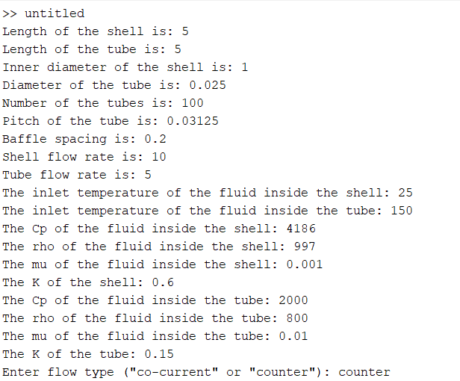
RESULT
Materials Selected
Shell Material: Stainless Steel
Tube Material: Carbon Steel
Shell Fluid: Cooling Water
Tube Fluid: Oil

Slide 24
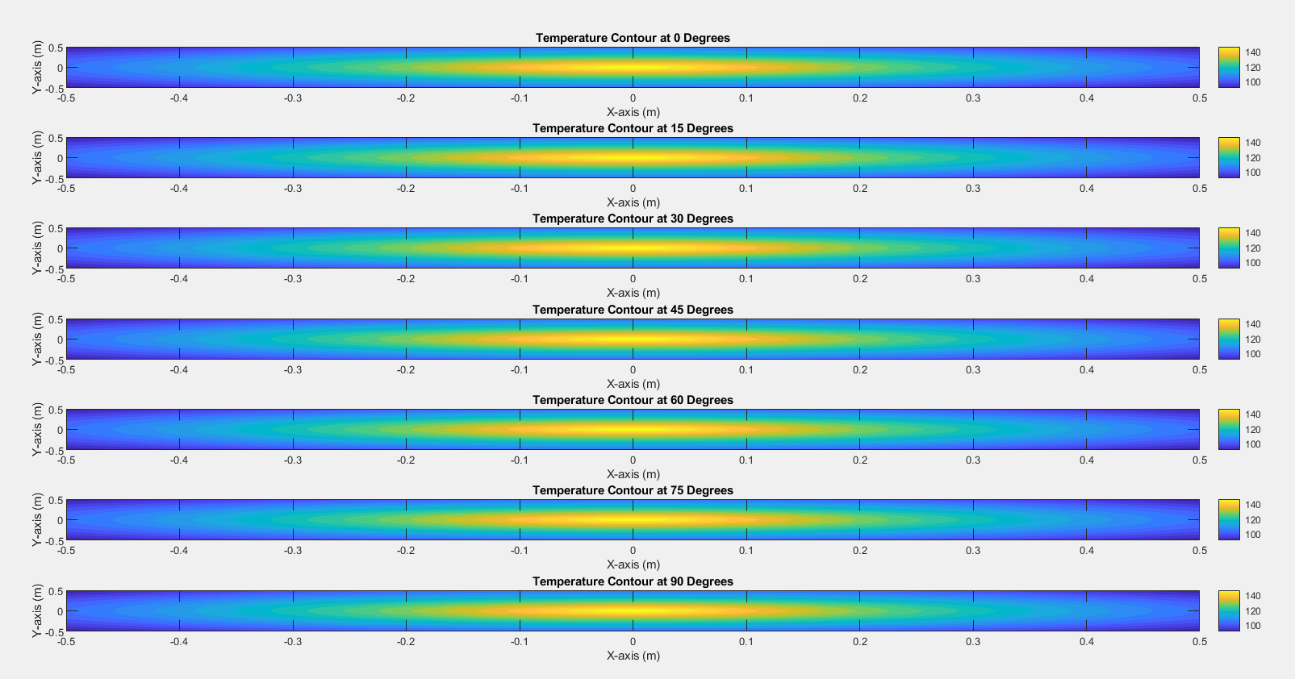

Slide 25
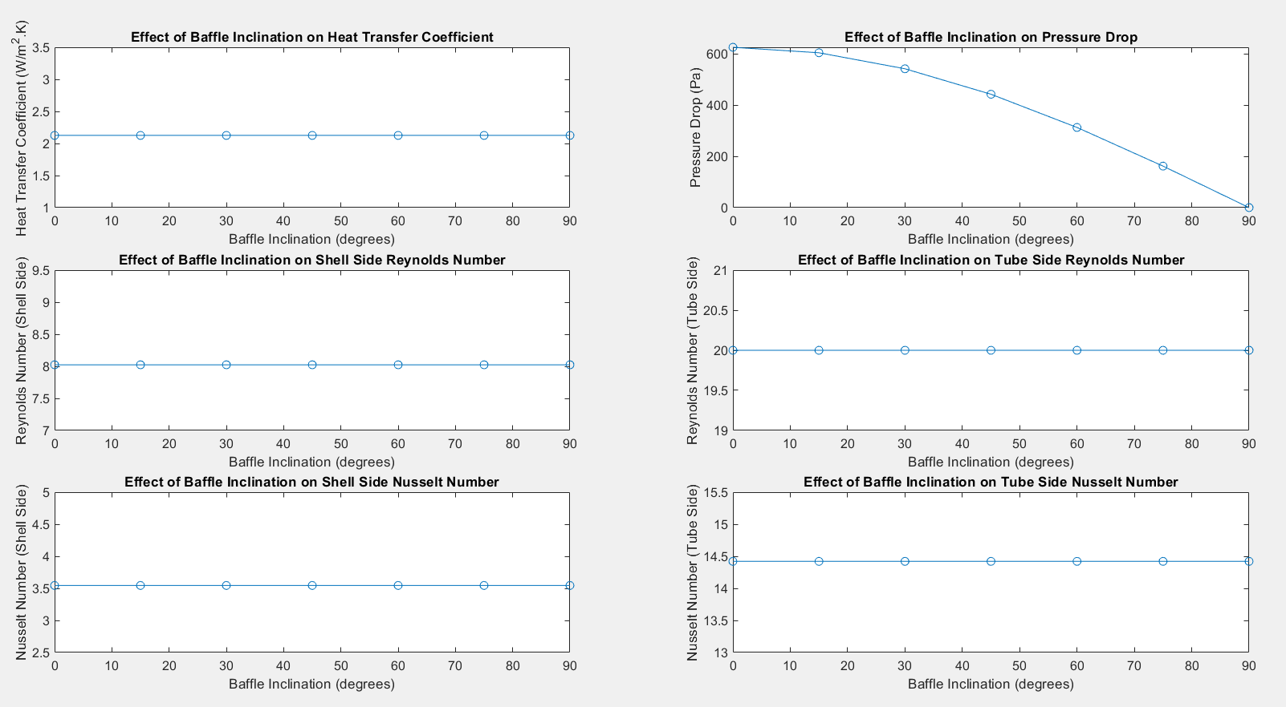

Slide 26
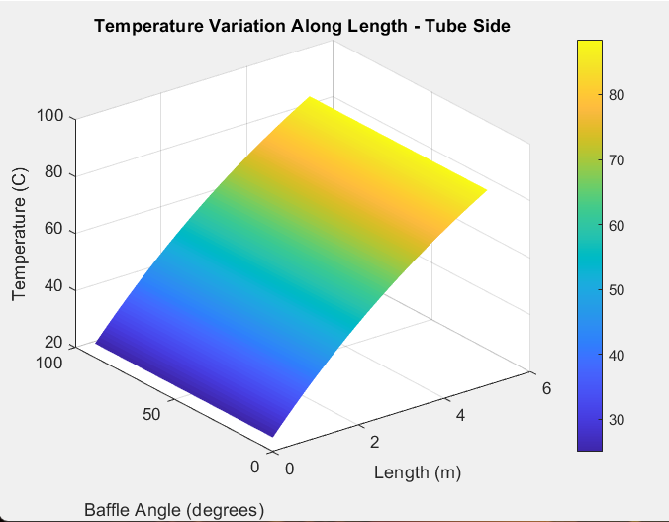
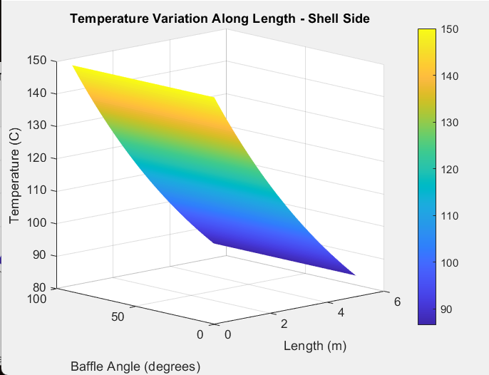

Slide 27
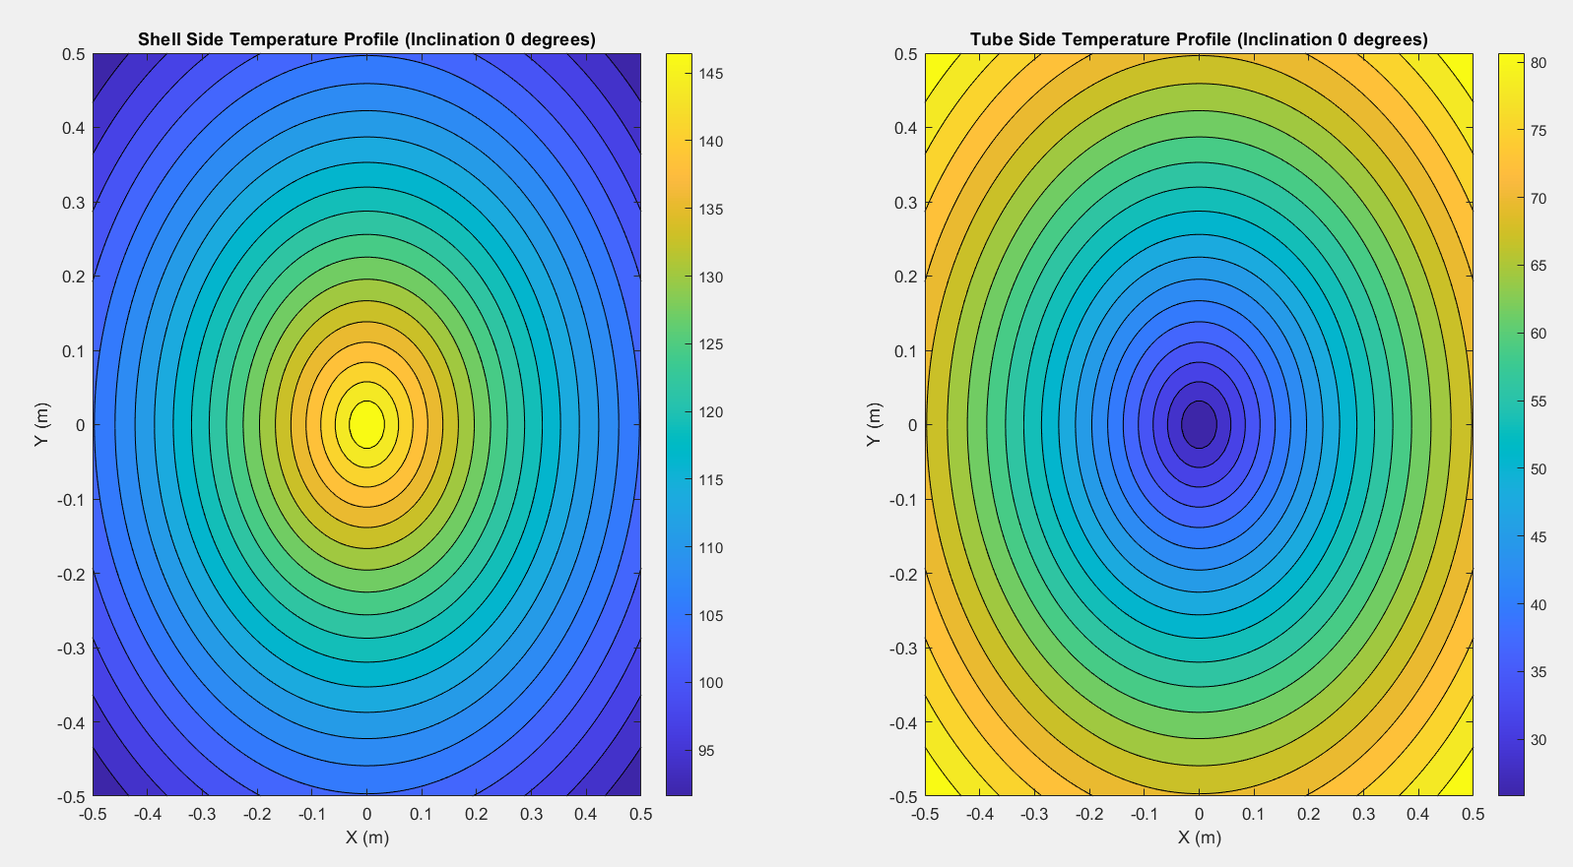
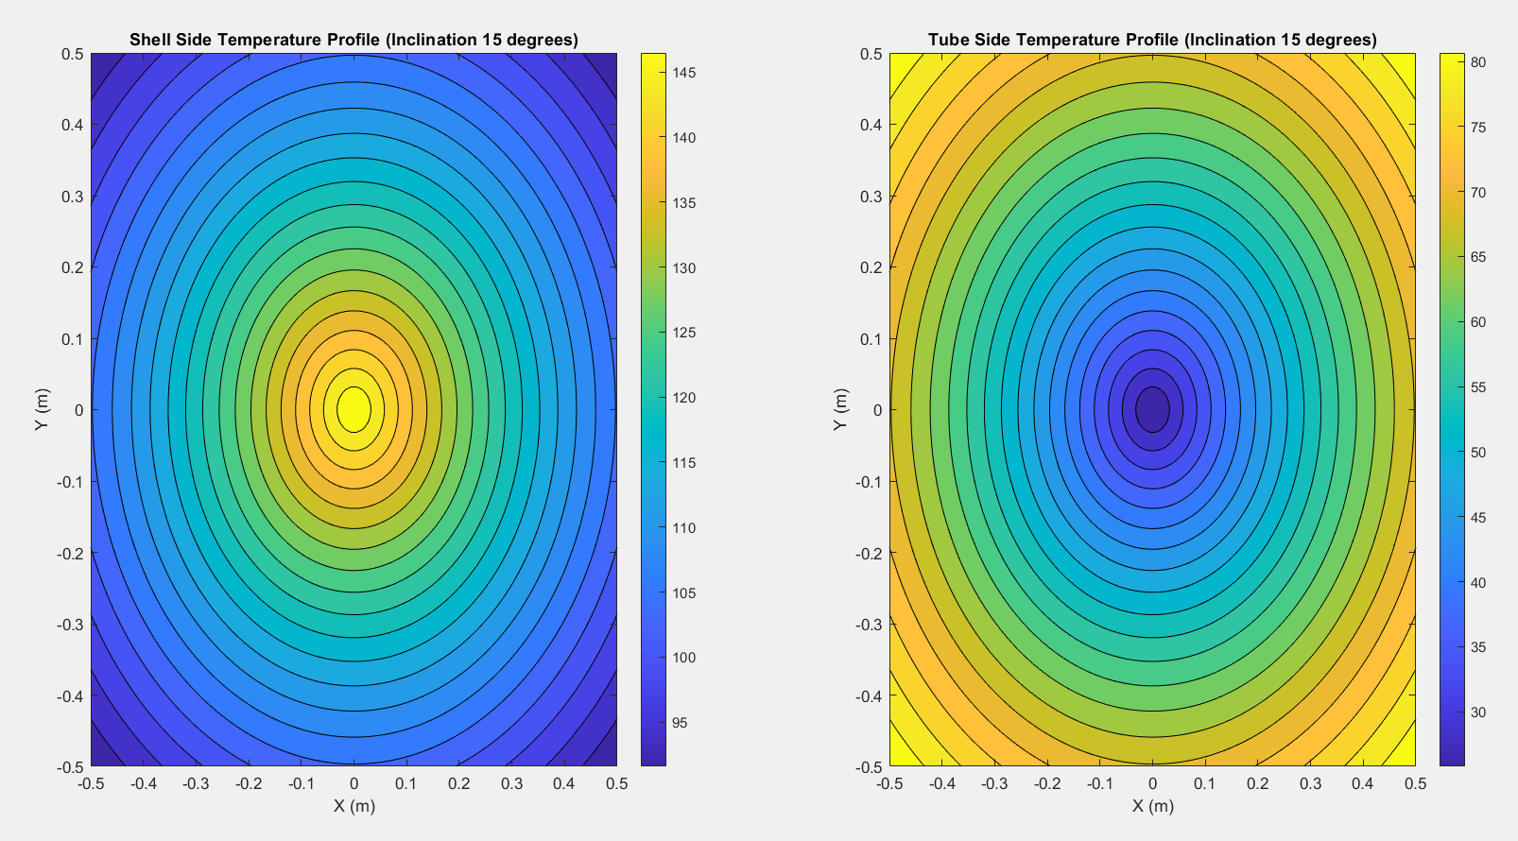

Slide 28
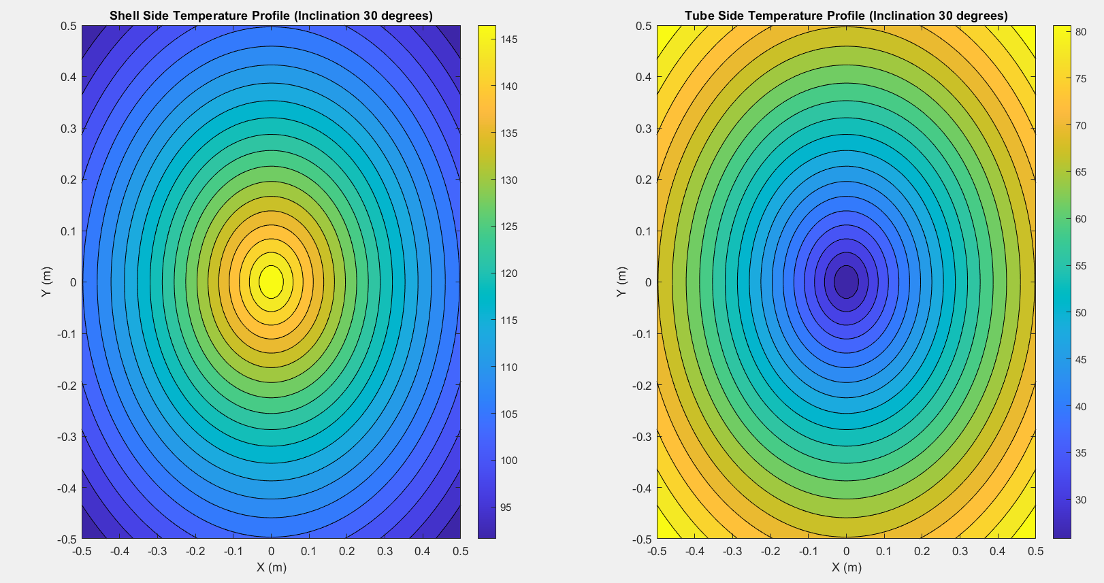
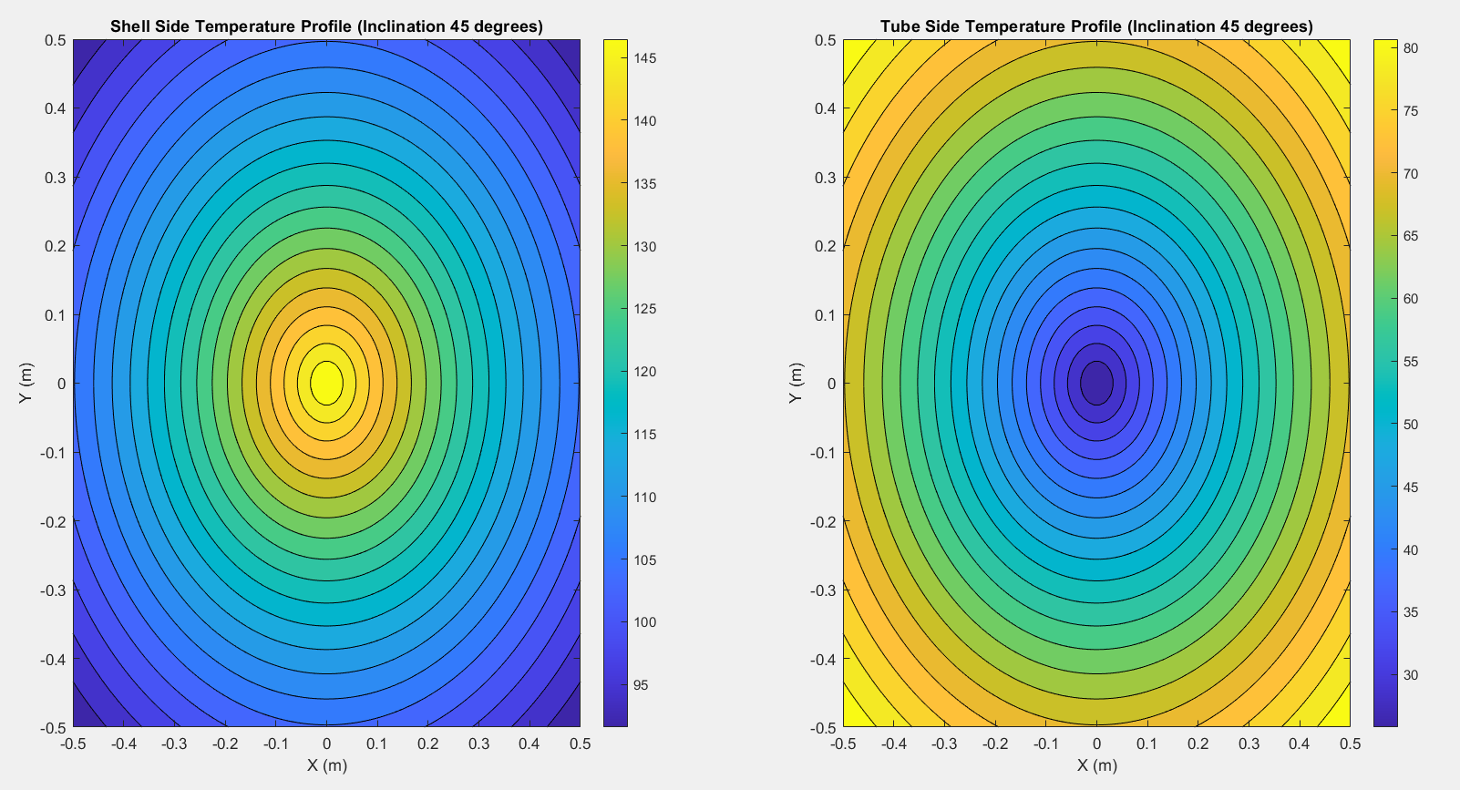

Slide 29
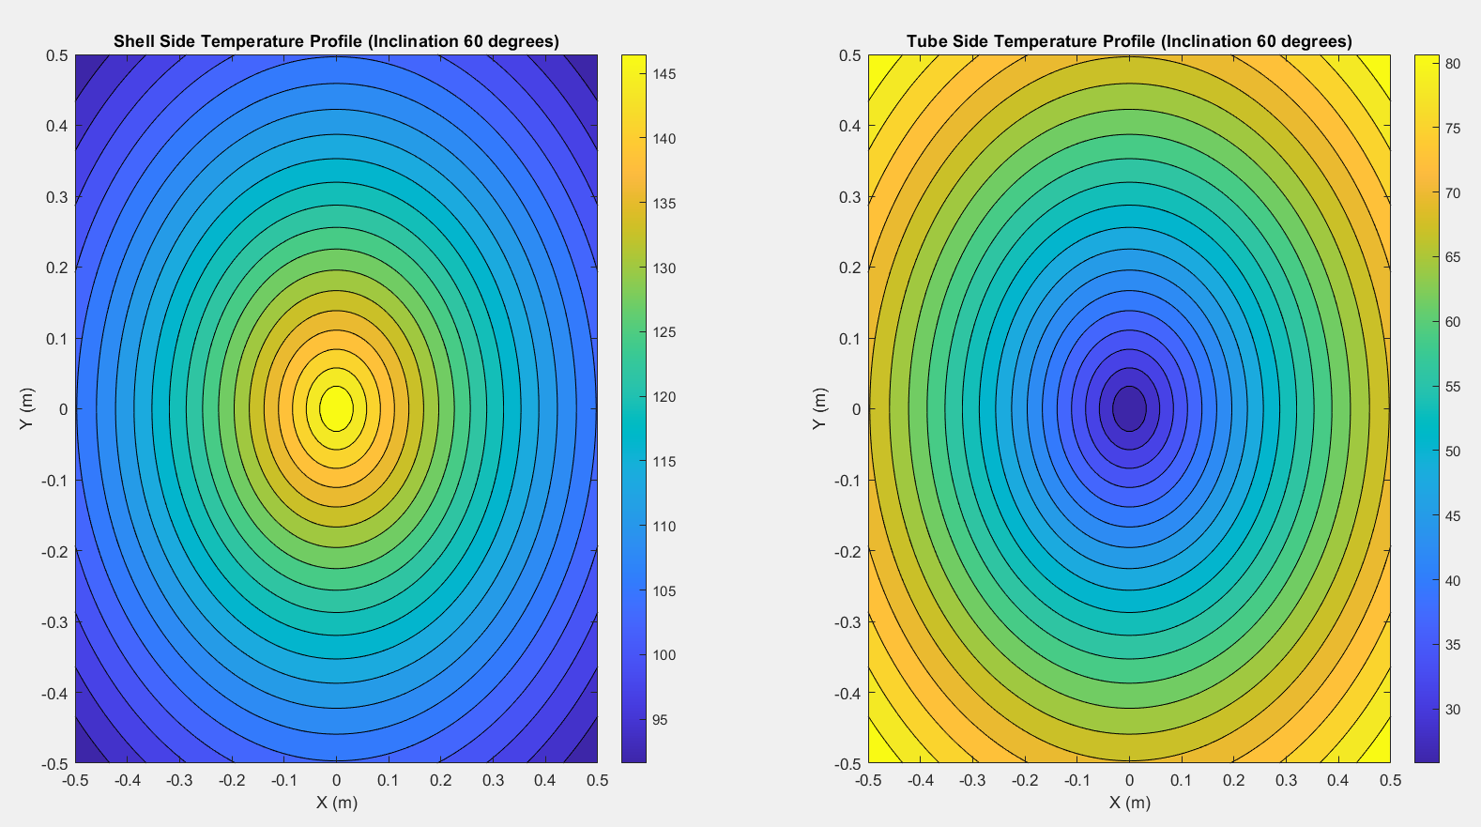
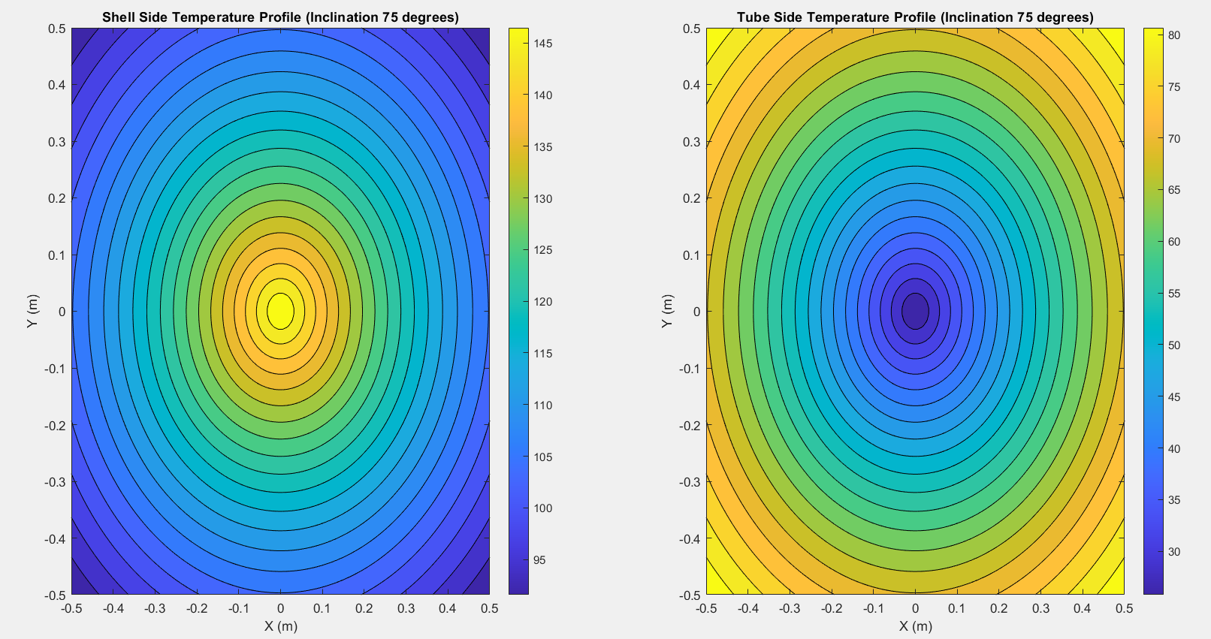

Slide 30

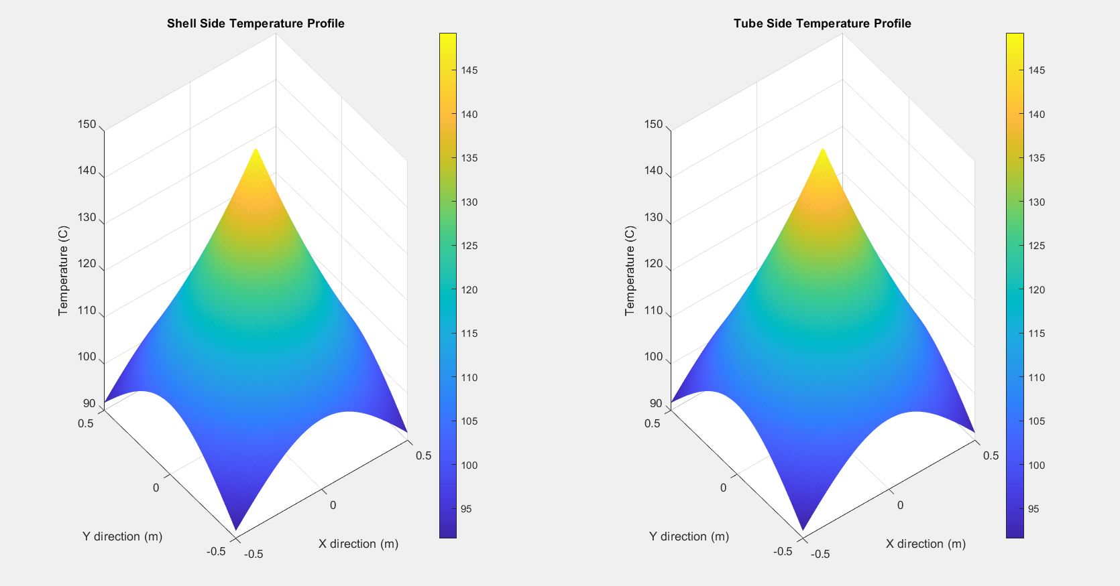

Slide 31
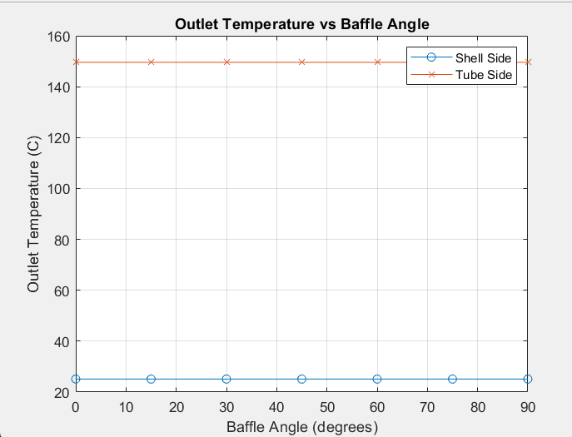

Slide 32
Conclusion
The analysis and design of shell and tube heat exchangers involve understanding the complex interactions between fluid dynamics and heat transfer. By optimizing parameters such as baffle spacing and fluid velocities, the efficiency of the heat exchanger can be significantly improved. MATLAB and its toolboxes provide robust tools for performing the necessary calculations and visualizations to design and analyze these heat exchangers effectively.

